Slide 1
COLOMBO CAFES REPORT
PRESENTED BY;
GROUP 9
DATA ANALYSIS, COHORT 2023/2034 USADF BENEFICIARY
LAST UPDATED:
1 MARCH, 2023.

Slide 2
CONTENTS
Objectives
Survey Data
Dashboard Visualization
Review
Descriptive Analysis
Conclusion

Slide 3
OBJECTIVES
The overall objectives of the survey data is to uncover hidden insights and interpret the data for COLOMBO CAFES
The specific objectives include:
What are the top city with exemplary café?
What are the top three exemplary café in the city?
What are the top streets with exemplary café?

Slide 4
SURVEY DATA
The survey data to be analyzed is COLOMBO CAFES
The software used to analyze survey data include:
  Microsoft Excel (Data Cleaning and Analysis)
  Microsoft Power BI (Interpretation and Visualization)
Source (Kaggle): https://www.kaggle.com/datasets/kanchana1990/colombo-cafes-ratings-and-insights-dataset

Slide 5
DASHBOARD VISUALIZATION

Slide 6
REVIEW
The city with exemplary café include Kaduwela, Urugodawatta and Sri Jayawardenepura Kotte
The exemplary café with good reviews include Tea Avenue, CafÃ© on the 5th and The Barnesburyach city
The streets with exemplary café include 08 Jawatta Rd, 4 Maitland Cres and 108 5th Ln

Slide 7
DESCRIPTIVE ANALYSIS
Total Score |  | Reviews Count
Mean | 4.258885017 | Mean | 191.2886
Standard Error | 0.032427838 | Standard Error | 26.04551
Median | 4.258885017 | Median | 10
Mode | 4.258885017 | Mode | 0
Standard Deviation | 0.600571957 | Standard Deviation | 482.3696
Sample Variance | 0.360686676 | Sample Variance | 232680.4
Kurtosis | 5.87301905 | Kurtosis | 19.3144
Skewness | -1.744362034 | Skewness | 4.048896
Range | 4 | Range | 3505
Minimum | 1 | Minimum | 0
Maximum | 5 | Maximum | 3505
Sum | 1460.797561 | Sum | 65612
Count | 343 | Count | 343

Slide 8
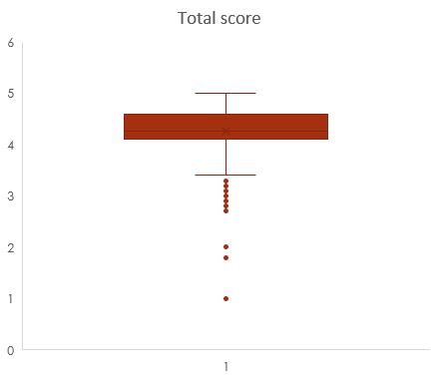
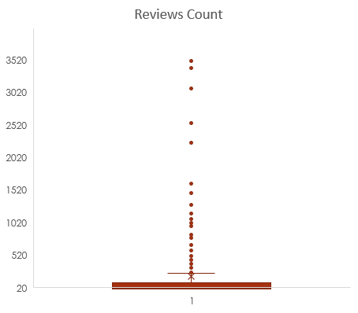
Normality Test using Box & Whisker Chart
The Total score and the Reviews count was plotted in a chart to ascertain if the data is normally distributed. The two plots indicates that there are no outliers.

Slide 9
Hypothesis Testing Using Z-test (Two Sample for Means)
Null hypothesis: There is no significant difference between the total score and the reviews count
Alternate hypothesis: The difference between the total score and the reviews count is statistically significant
Significance value (P-value) = 0.05
Since P-value is 1.95 which is greater than 0.05, therefore we do not reject null hypothesis
Therefore, we can conclude that there is no significant difference between the total score and the reviews count
 | Total Score | Reviews Count
Mean | 4.258885017 | 191.2886297
Known Variance | 0.36068668 | 232680
Observations | 343 | 343
Hypothesized Mean Difference | 0
z | -7.180883434
P(Z<=z) one-tail | 3.46279E-13
z Critical one-tail | 1.644853627
P(Z<=z) two-tail | 6.92557E-13
z Critical two-tail | 1.959963985
Total score: This is the average customer rating for each café
Review count: This is the number reviews for each café

Slide 10
CONCLUSION
In conclusion, the top city with exemplary café is in Colombo and this is dependent on the street and the category name.

Slide 11
THANK YOU.

